Slide 1
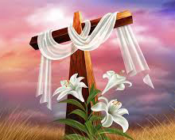
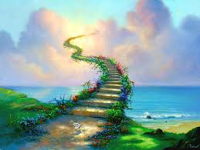
LCCC 30 Years!
LCCC 30 周年
Dr. Hamilton

Slide 2
Because of the Lord’s great love we are not consumed, for his compassions never fail. They are new every morning; great is your faithfulness.
我们不致消灭，是出于耶和华诸般的慈爱，是因他的怜悯不至断绝。每早晨这都是新的，你的诚实极其广大。
Lamentations 耶利米哀歌 3:22-23

Slide 3
God has shown his faithfulness to the ministry of LCCC. Why?
为什么神对 LCCC 的事工表现出他的信实?

Slide 4
LCCC did not have a full time pastor for most of those years
30年的大部分时间里，LCCC没有全职牧师
a pastor
牧师
a flock of sheep
群羊
Shepherd 牧羊人

Slide 5
Over the years LCCC has been a church of a constantly changing congregation.
多年来，LCCC的会众不断变化。
Faithful God
信实的神
New People
新人

Slide 6
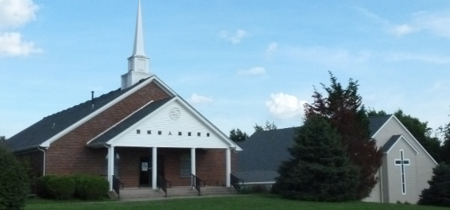
I believe God has honored your vision to take the ministry of LCCC beyond this church building.
我相信上帝已经满足了你们的预想,让LCCC的事工超越了这座教堂建筑。

Slide 7
I believe God has honored your faithfulness to biblical truth.
我相信上帝已经认可你们对圣经真理的忠实。

Slide 8
I am grateful for the way LCCC has made some modifications in their worship service on Sundays, moving from a traditional only type of worship service to a mix of the traditional and contemporary.
我很感激LCCC在周日礼拜仪式上做出了一些改变，从传统的单一礼拜仪式转变为传统与现代的混合形式。

Slide 9
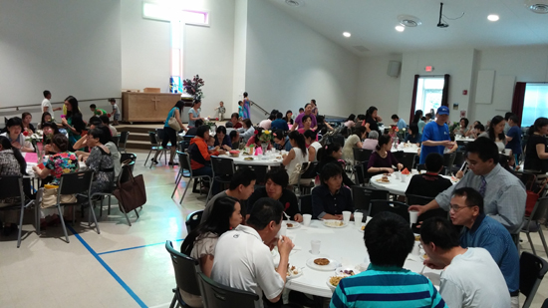
I am not sure how the idea of the love feast after morning worship started.
我不知道爱宴是什么时候开始的。

Slide 10
I am convinced that one reason the Lord has so blessed the ministry of LCCC over the years is that you have kept Jesus the center of everything.
我深信主多年来如此祝福LCCC事工的原因之一是你们以耶稣成为一切的中心。

Slide 11
Shirley and I are privileged to have played a part in the ministry of LCCC over the years.
多年来，雪莉和我很荣幸能够参与LCCC的事工。

